Slide 1


Slide 2

Mărțișor – Martenitsa
A Shared Spring Story
A celebration of renewal, friendship and shared heritage
Moldova • Romania • Bulgaria
“Different languages, one red-and-white thread.”

Slide 3
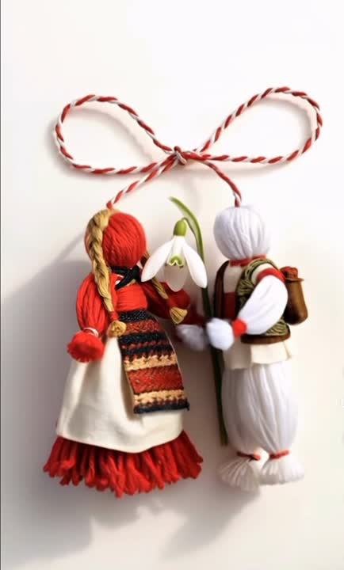
What Is This Tradition About?
Celebrated on March 1st across our three countries
A small red and white talisman worn throughout March
Symbolizes health, hope and new beginnings
Think of it as spring’s diplomatic badge of honor.

Slide 4
Martenitsa
A Bulgarian Spring Tradition
On the 1st of March, we welcome spring with Martenitsi — delicate red and white threads exchanged as wishes for health and joy.
Today, you are not only our guests — you are part of the tradition.

Slide 5
A Little Folklore
The tradition is linked to Baba Marta — Grandmother March — who brings spring with a bit of personality.
If March weather changes quickly, we smile and say:
“Baba Marta is in one of her moods.”
This is a millennia old bulgarian custom prior to Eastern Europe arrival

Slide 6
A LEGEND OF MARTENITSA
A promise between friends that spring will always come again
A martenitsa is never bought for oneself, it must be given
it is, at its heart, an act of good will and friendship

Slide 7
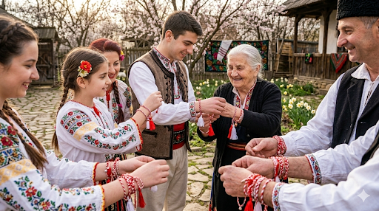

Slide 8
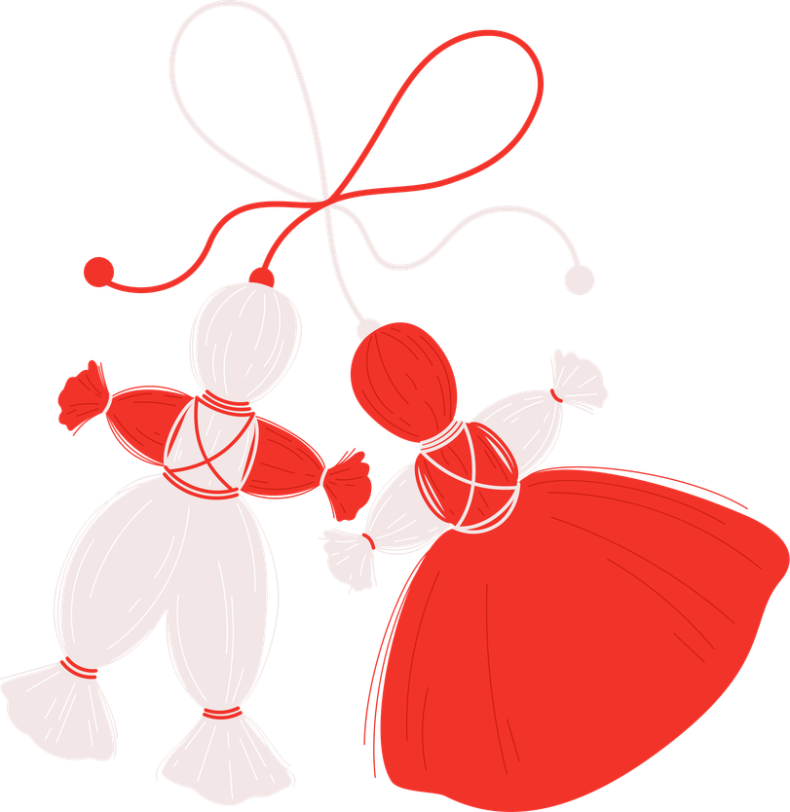
The Beauty of Red & White
Red symbolizes vitality, life and courage
White represents purity, hope and new beginings.
Together they create harmony:
balanced, elegant, and full of warmth.
The white and red dolls are called
Pizho and Penda

Slide 9
How to Wear It
Wear your Martenitsa on your wrist or jacket.
Keep it until you see a blossoming tree or a stork.
Then tie it to a branch — returning your wish to nature.
It is perhaps the only accessory with seasonal instructions.

Slide 10
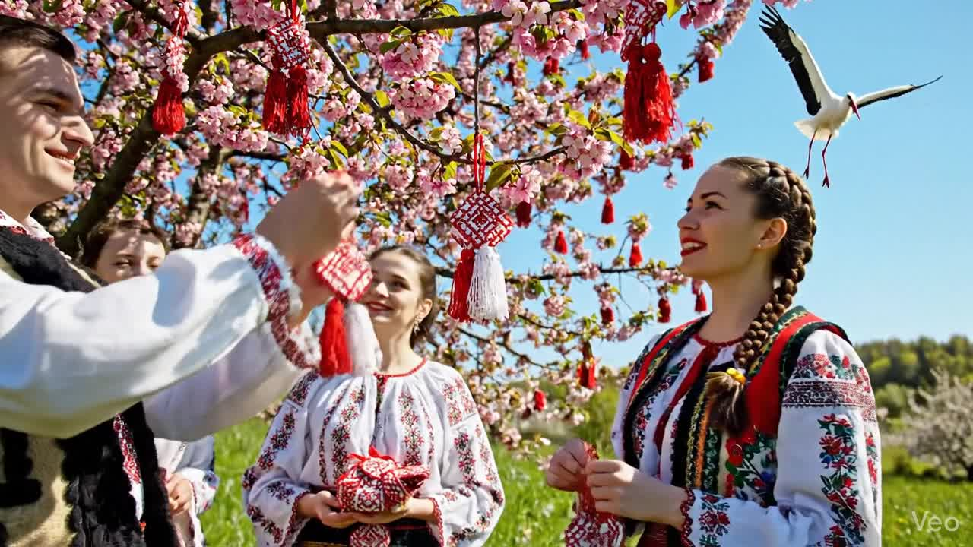

Slide 11
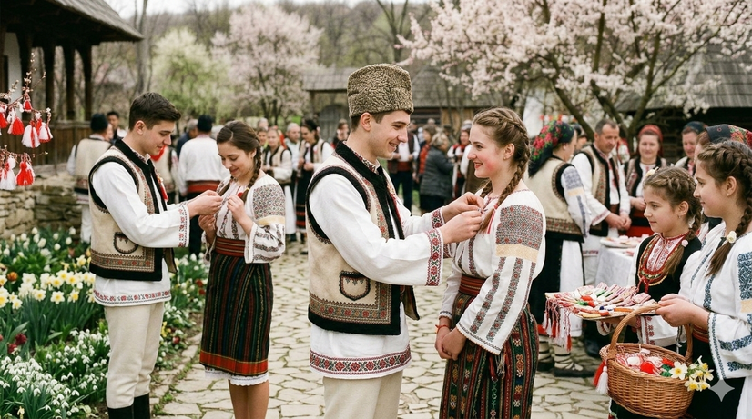
Romania – How we wear it
Martisor is a small symbolic item that men offer to women on March 1 as a sign of love and respect.
They are usually small items, such as handmade flowers, jewelry and figurines tied with a red and white entwined cord.

Slide 12
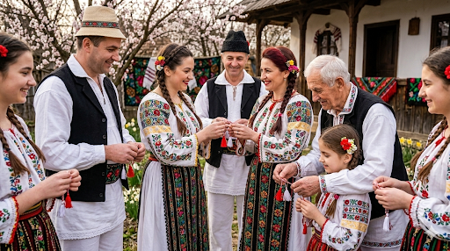
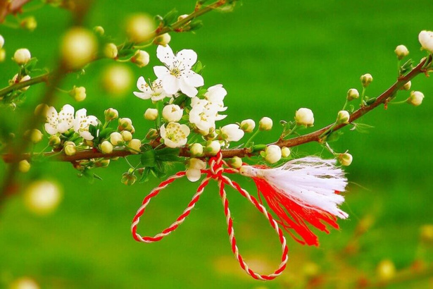
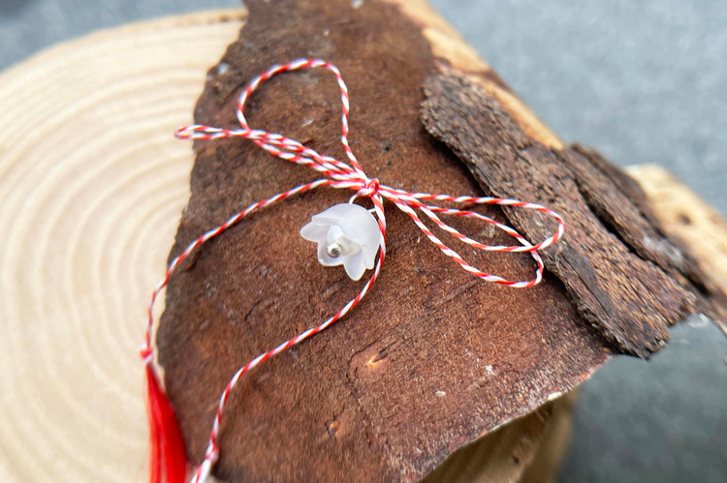
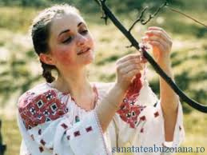

Slide 13
Babele and Baba Dochia Legend
The first nine days of March are called Babele in Romania. Besides being a rather funny custom, this is also an important local tradition.
The women have to pick a day from one to nine (pick a baba) to find out how the coming year will be.
Deep roots in ancient folklore
Connected to the legend of Baba Dochia
Romanian spring can be unpredictable — just like Baba Dochia’s moods!

Slide 14
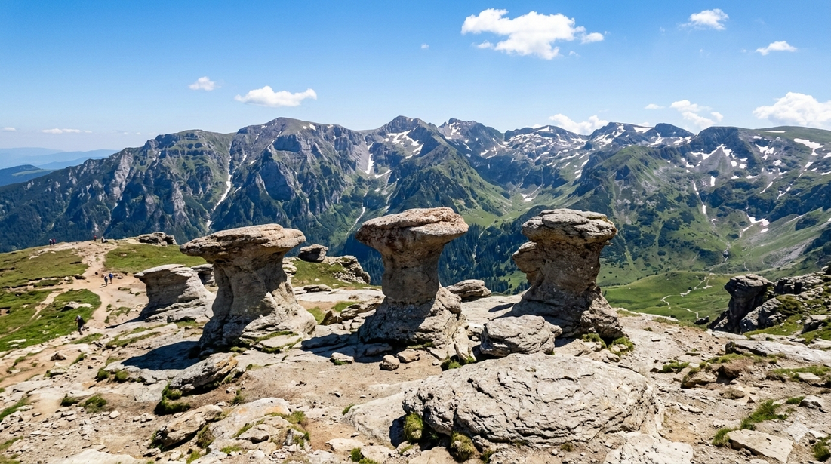
Babele in Bucegi Mountains

Slide 15
40 mucenici (40 martyrs)
Every year on March 9, the Orthodox Church celebrates the Forty Martyrs: these were Roman soldiers who lived in the time of Emperor Licinius were tortured and executed for their Christian beliefs
Romanian women bake a special dessert for this day, called mucenici (or little saints). The pastries are made in the shape of number 8 and men have to drink 40 glasses of wine

Slide 16
Moldova – A Gesture from the Heart
Mărțișor is offered to women, men, children, friends and colleagues
Often worn near the heart or on the wrist
Then tied to a blossomed branch last day of March
Moldovans usually offer snowdrops along with mărțișor for the first day of spring
In Moldova, it is less about protocol and more about showing affection.

Slide 17

Legend of Martisor

Slide 18
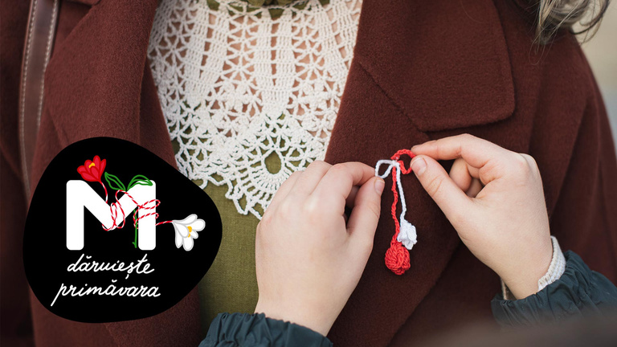
How to Wear It
Wear your Martisor near the heart starting March 1st
Keep it the entire month of March or until you see a blossomed tree, then tie it to a blossomed branch and make a wish

Slide 19
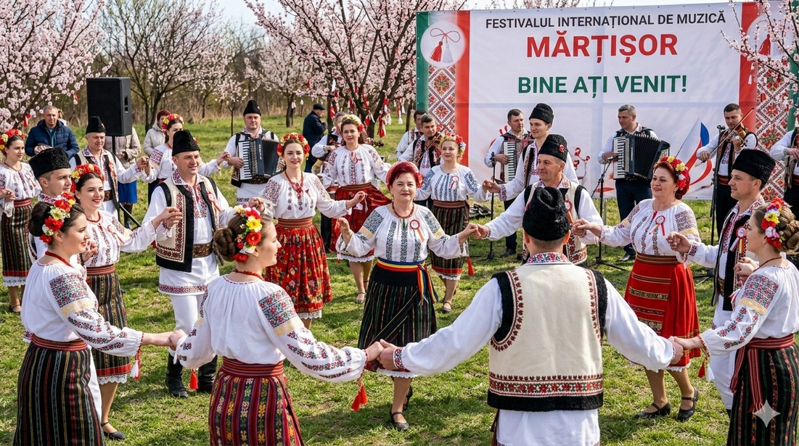
Martisor festival

Slide 20
Beautiful Differences
Moldova: A symbol of affection and heartfelt connection
Romania: Strongly rooted in folklore and legend
Bulgaria: Closely tied to nature signs and seasonal rituals
Three interpretations, one shared spirit.

Slide 21
Shared Meaning Across Borders
Red: Life, vitality, strength, courage
White: Purity, hope, new beginnings
Twisted together: Unity and harmony
A simple thread — carrying centuries of history.

Slide 22
A UNESCO Recognized Tradition
In 2017, the tradition was inscribed on UNESCO’s Intangible Cultural Heritage list
A joint recognition of Bulgaria, Romania, Moldova and North Macedonia
Proof that cultural diplomacy sometimes begins with something very small.

Slide 23
Today’s Celebration
Exchanged in schools, offices and diplomatic circles
Artisans create modern interpretations each year
A tradition passed gently from generation to generation
Spring may arrive at different speeds — but it arrives for all of us.

Slide 24
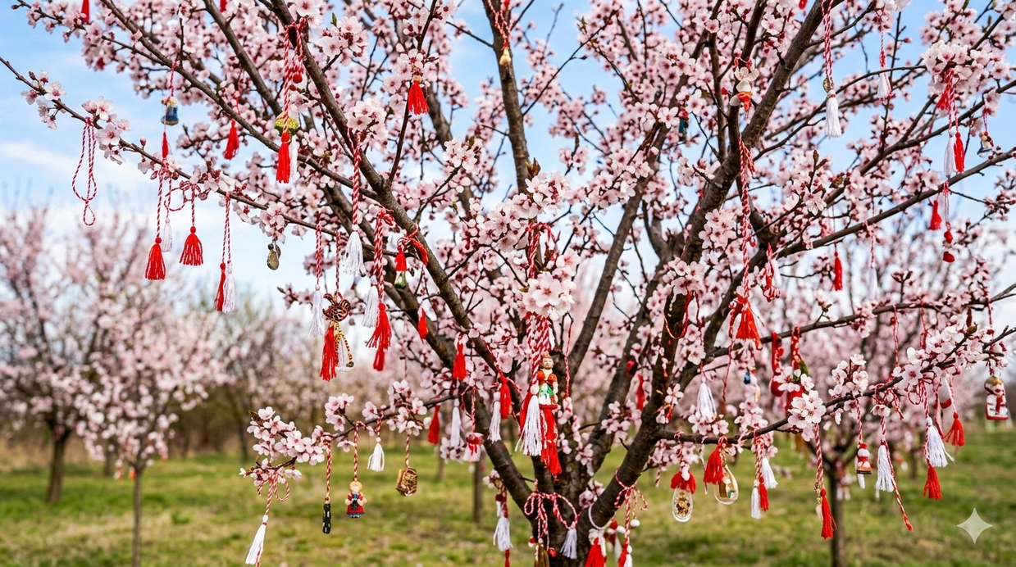
Happy Mărțișor! Happy Martenitsa!

